Slide 1
MGMT590 - Visual Analytics
Session 7
Dr. Cecilia Ying
Updated: 09/14/2025

Slide 2
Today’s Agenda
Session 4
Special graphs “show and tell”
Module 5: Effective Visualization
Visualization in Operations Management Research (Dasole et al. 2022)
Visualization in Supply Chain & Decision Making (Lou et al. 2020)
Hands-on Exercises
GenAI Tool – Copilot
Power BI 101

Slide 3

Special Graph “Show and tell”

Slide 4
Module 5: Effective Visualization
Overview

Slide 5
Visualizing Relational, Distributions, Categorical Data
The three main types
Relational
Scatter plots, heatmaps, network diagrams
Distribution
Data shape, central tendency, outliers
Categorical
Comparing categories, proportions
Categorical or nominal data
Correlations, relationships between variables
Histograms, box plots, density plots
Continuous or numerical data
Continuous or discrete data
Bar charts, pie charts, violin plots, stacked bar charts
Remember this from Week 2?

Slide 6
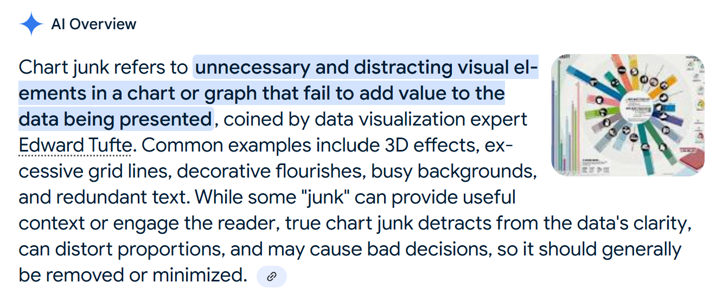

Part 1: Key findings from the survey
Most familiar and frequently used
Methods: Sketching and wireframing/mockups were significantly more familiar and used than other methods
Principle: On average, the most familiar principle was chart junk

Slide 7
Articulating the Story: The “HOW”
Clear, memorable, and persuasive
1. Choosing the Right Visuals – The Vehicle
Don’t be fancy.
Be clear instead
The visual is the primary interface between the audience and your data
Obscure or even misrepresent your message
BAD
GOOD
Make the insight obvious without a single word

Slide 8
Visualization in Operations Management Research
Basole, R., Bendoly, E., Chandrasekaran, A., & Linderman, K. (2022). INFORMS Journal on Data Science, 1(2), 172-187.
Context
Availability of data + variety of tools for visualization = opportunities & challenges
Visualization
Used appropriately: complement, aid, and augment the researcher’s understanding
Used incorrectly/ without sufficient consideration: yield misleading and erroneous claims

Slide 9
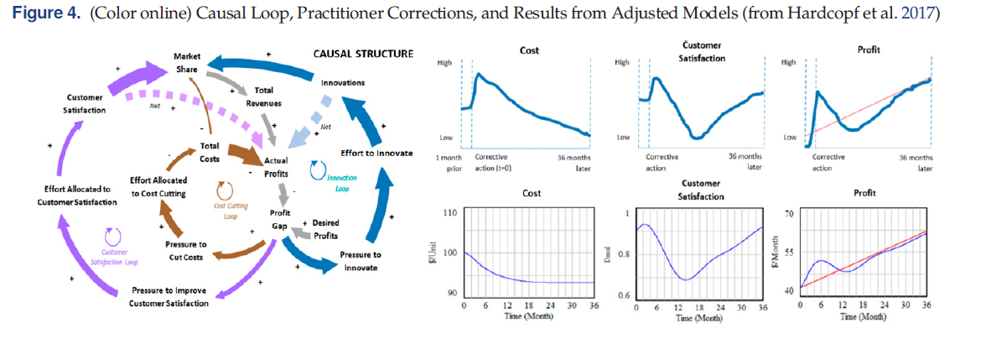
Communicate ideas, data, and findings effectively
Iteratively used with case interview protocols

Slide 10
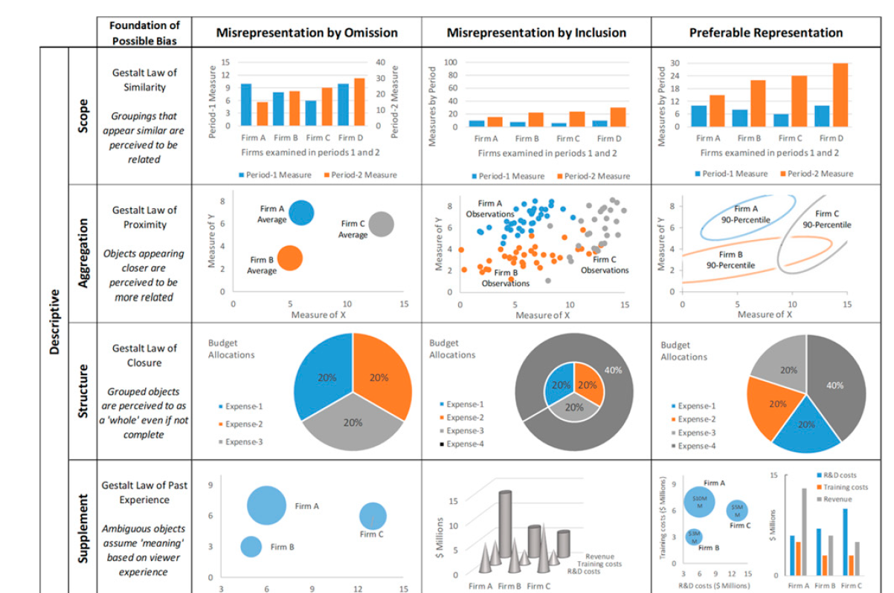
Misrepresentation concerns – Descriptive Analytics
Misrepresentation by omission vs. by inclusion

Slide 11
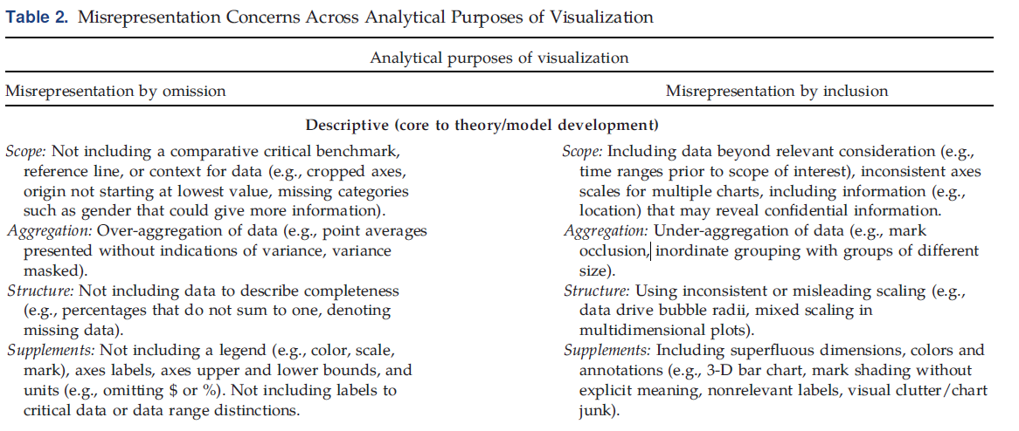
Misrepresentation concerns – Descriptive Analytics
Misrepresentation by omission vs. by inclusion

Slide 12
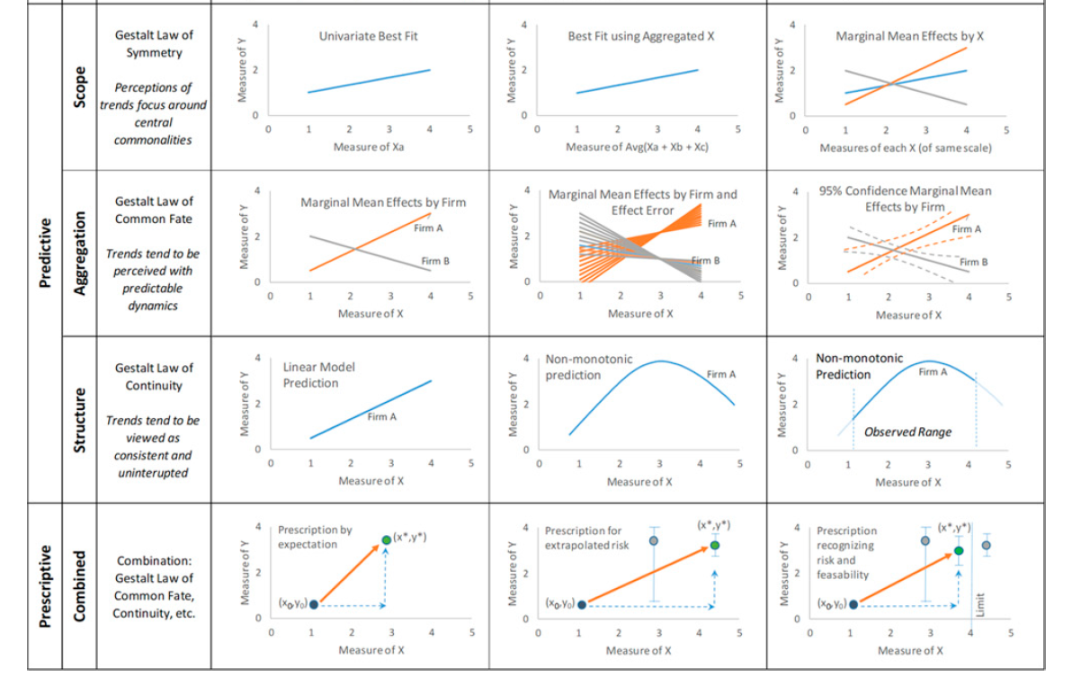
Misrepresentation concerns – Predictive & Prescriptive
Misrepresentation by omission vs. by inclusion

Slide 13
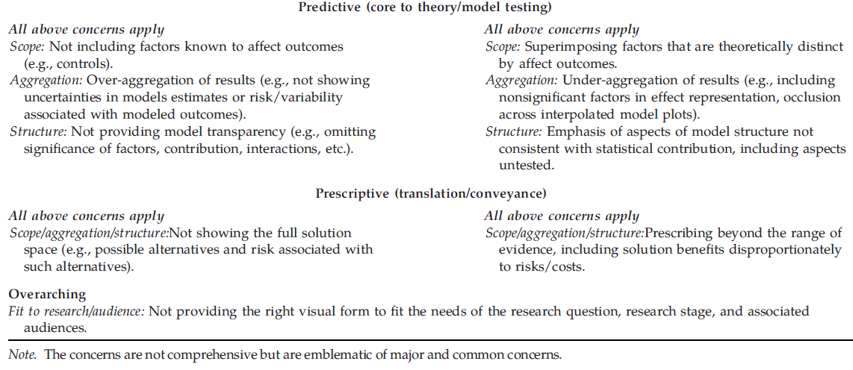
Misrepresentation concerns – Predictive & Prescriptive
Misrepresentation by omission vs. by inclusion

Slide 14
Trends and Directions in Data
Types of data
Data Collection
People, process, organization, and ecosystem
Batch-level data vs. dynamically refreshed, real-time and streaming data
Structured qualitative and quantitative data vs. unstructured data (text, audio, images, videos)
Timing & Frequency
Data Type

Slide 15

Data Collection
Types of Data Sources
Files
Data processed in large quantities at regular intervals
For example, data stored in databases (relational, NoSQL)
Streaming (Real-time)
Continuous flow of data generated real-time
Typically stored and processed in bulk
Static collection of data in files stored on disk or cloud storage
Batch Data
For example, documents (PDF, Word doc), spreadsheets (xlsx, csv), or data dumps of mixed formats (video, audio files)
For example, sources like sensors (IoT devices), social media, and real-time videos and logs

Slide 16
Trends and Directions in Techniques
Improve quantitative reasoning while reducing cognitive burdens
Use of Gen AI in the visual design process
ML-based image processing & text analytics approaches
Using unstructured data -> visualize structure, sentiment, and abnormalities
Integrating electronic medical records with data collected from wearable (like Fitbit or AppleWatch)
Visualize health data to study disease progression
With data such as electrocardiogram
Personalized and customized visualization and dashboard

Slide 17
Visualization in Supply Chain & Decision Making
Lou et al. (2020). In 2020 24th International Conference Information Visualisation (IV) (pp. 746-750). IEEE.
Supply chain visualization and risk management
Business process discovery and management
Manufacturing data visualization
Decision-making and data insights generation
Notes:
Lou, C. X., Bonti, A., Prokofieva, M., Abdelrazek, M., & Kari, S. M. C. (2020, September). Literature Review on Visualization in Supply Chain & Decision Making. In 2020 24th International Conference Information Visualisation (IV) (pp. 746-750). IEEE.

Slide 18
Types of Tools & How They Are Used
Lou et al. (2020) – IEEE
Free, customizable, and domain-specific tools are more popular in the real world
Tableau & Power BI are not the only ones out there
RiskVis
Generalized Treemaps
Calendar View Map
Disco
Celonis
Web-based Interactive Visualization Prototype
Graphical Model.
RiskVis: A supply chain visualization platform with risk management and real-time monitoring capabilities.
Generalized Treemaps: Used for visualizing business data, specifically for representing distribution of cases among different employees in an organization.
Calendar View Map: Used for manufacturing data visualization to expose outliers in production lines.
Disco: A tool for discovering business processes through visualization.
Celonis: A tool for process mining and visualization (not described in detail in the provided chunks, but mentioned alongside Disco).
Web-based Interactive Visualization Prototype: A proposed prototype for visualizing supply chain data and facilitating decision-making.
Graphical Model: Used for visualizing supply chain data, specifically for optimal transportation planning.

Slide 19
Hands-on Practice
In-class exercise with Copilot

Slide 20
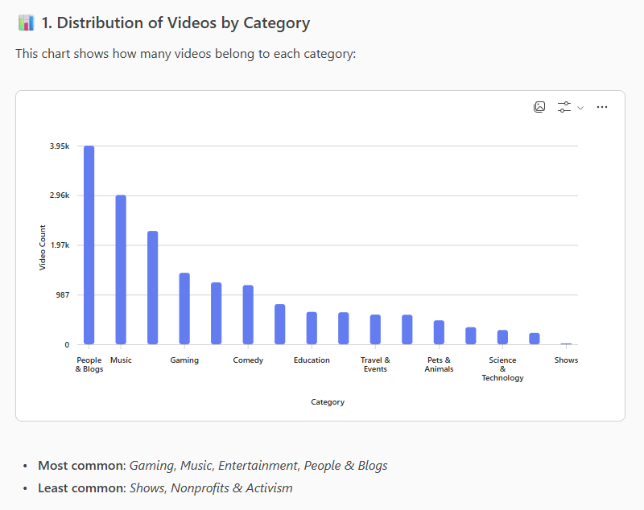
GenAI tool – Copilot
GenAI can generate your graphs. But does it do it well?

Slide 21
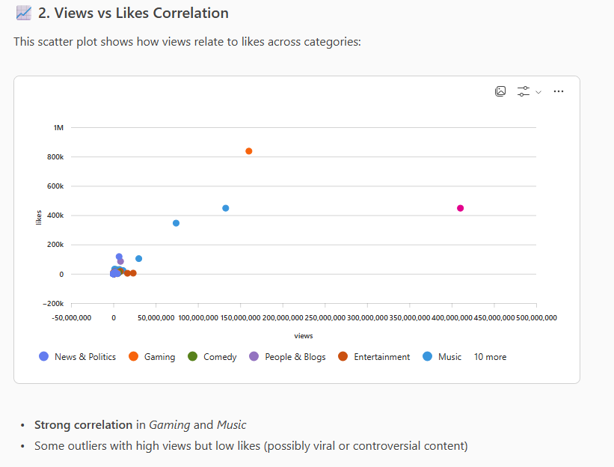
GenAI tool – Copilot
GenAI can generate your graphs. But does it do it well?

Slide 22
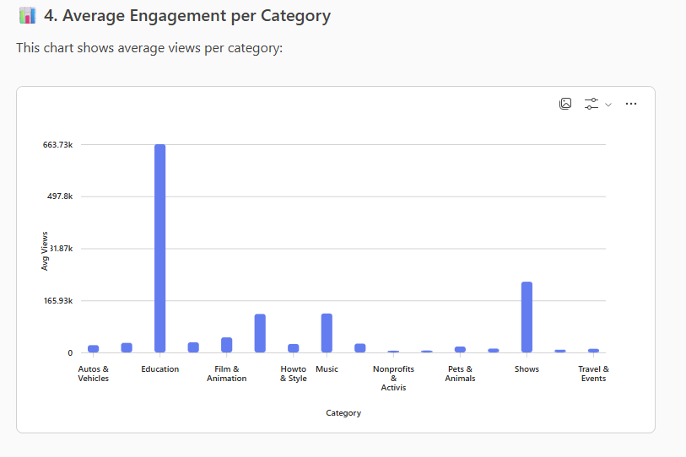
GenAI tool – Copilot
GenAI can generate your graphs. But does it do it well?

Slide 23
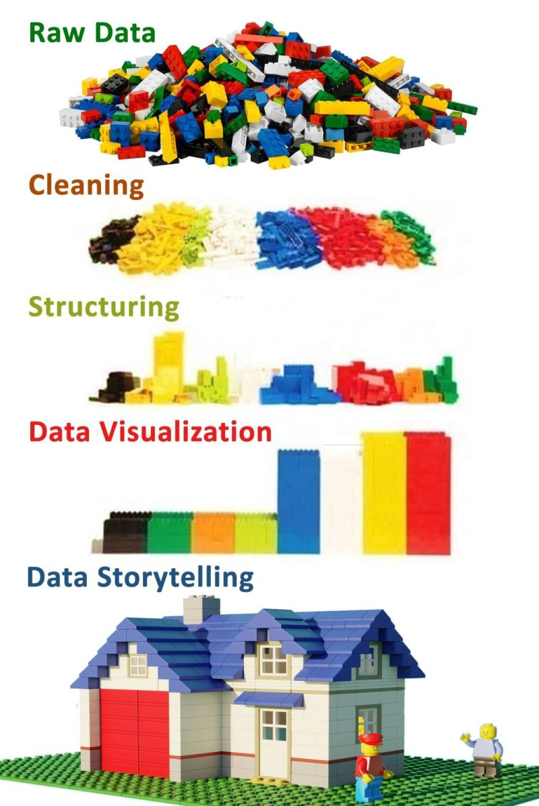
Storytelling with data
It’s just like building a house
Crafting the story
The architecture and blueprint
Creating a functional structure that meets the audience's needs.
Articulating the story
The construction and interior design
Using the right materials (visuals), a tidy look (decluttering), and clear signs (language) will make the house comfortable and easy to navigate.

Slide 24
WHAT is the story you are trying to tell?
Finding the narrative hidden within the data
1. Audience & Context (The Foundation)
2. The “Big Idea” (The Core Message)
3. The Narrative Arc (The Structure)
4. Conflict & Stakes (The Hook)

Slide 25
Articulating the Story: The “HOW”
Clear, memorable, and persuasive
1. Choosing the Right Visuals (The Vehicle)
2. Focusing Attention (The Spotlight)
3. Clear and Concise (The Script)
4. The Narrative Flow (The Guideposts)

Slide 26

What is our “Big Idea” from the YouTube Data?
What else do we need to show to support our “Big Idea”?
Let’s brainstorm

Slide 27
Hands-on Practice
Getting Started with Power BI

Slide 28
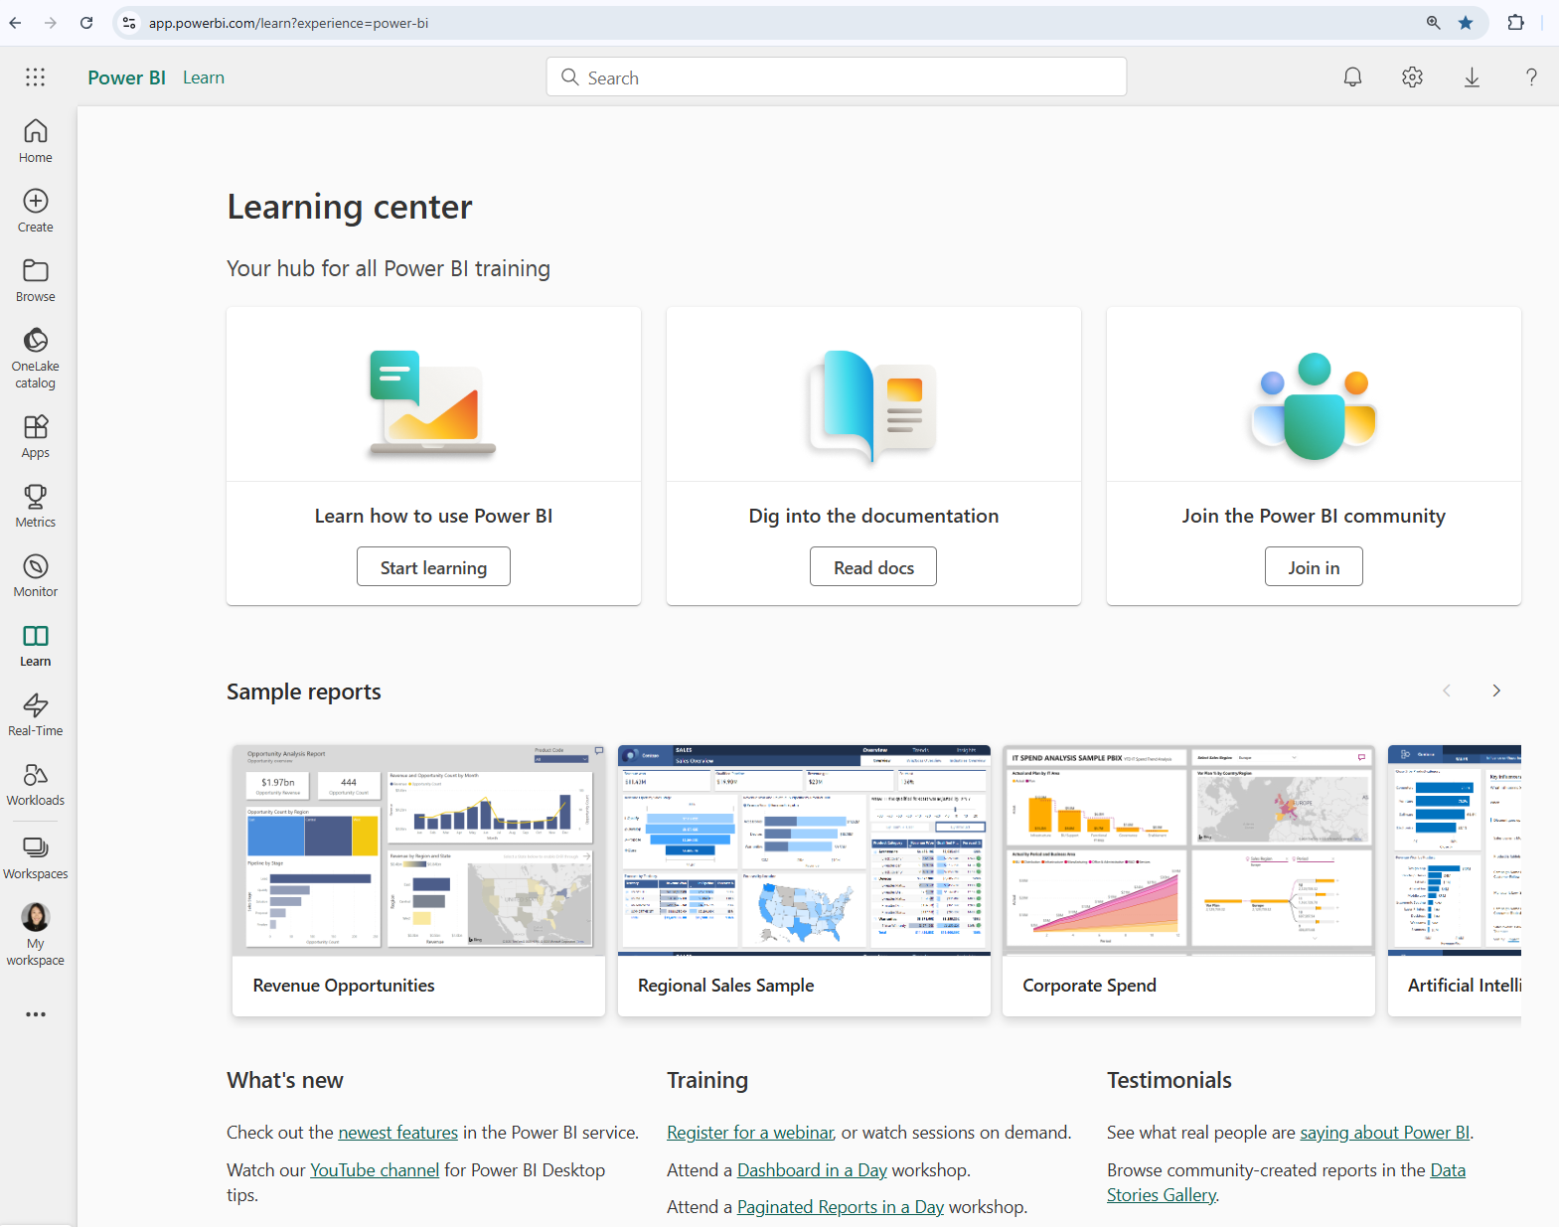
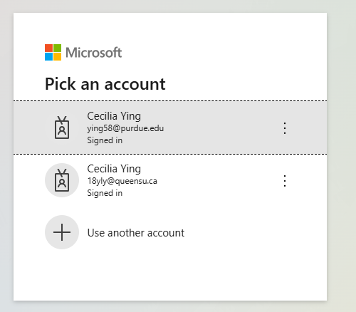
Account Setup & Sign in
Purdue emails
https://app.powerbi.com/learn?experience=power-bi

Slide 29
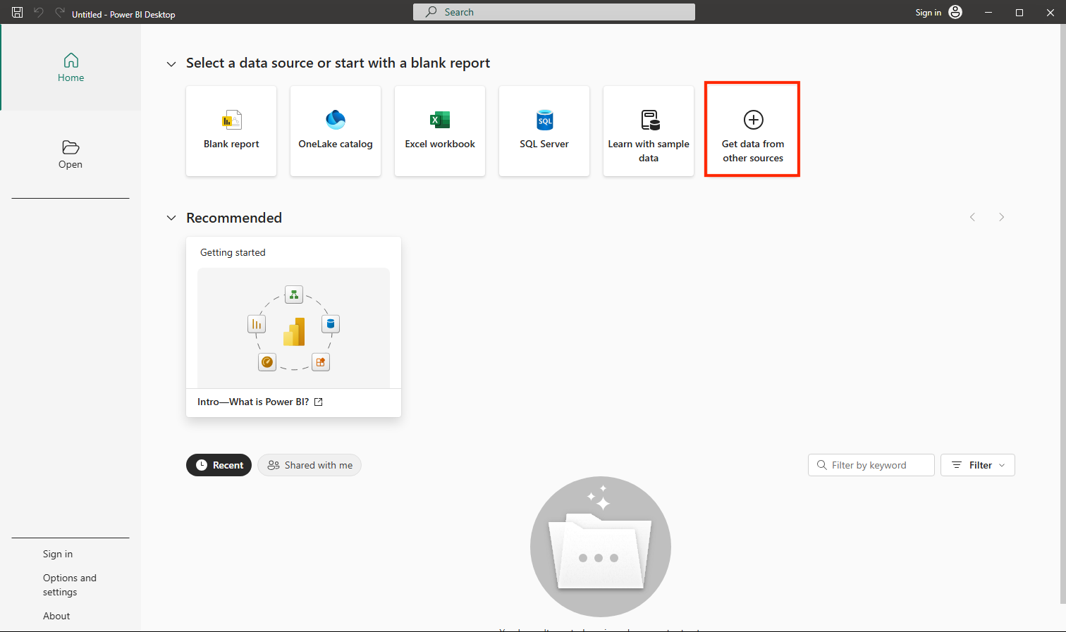
Power BI 101 – Explore Fundamentals of Data Visualization
https://microsoftlearning.github.io/DP-900T00A-Azure-Data-Fundamentals/Instructions/Labs/dp900-pbi-06-lab.html

Slide 30
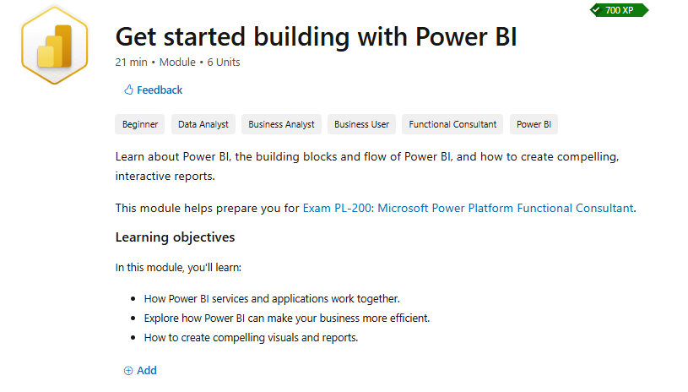
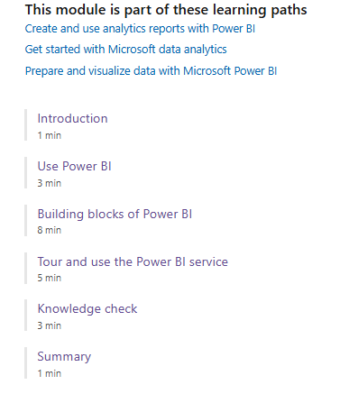
Building with Power BI
https://learn.microsoft.com/en-us/training/modules/get-started-with-power-bi/

Slide 31
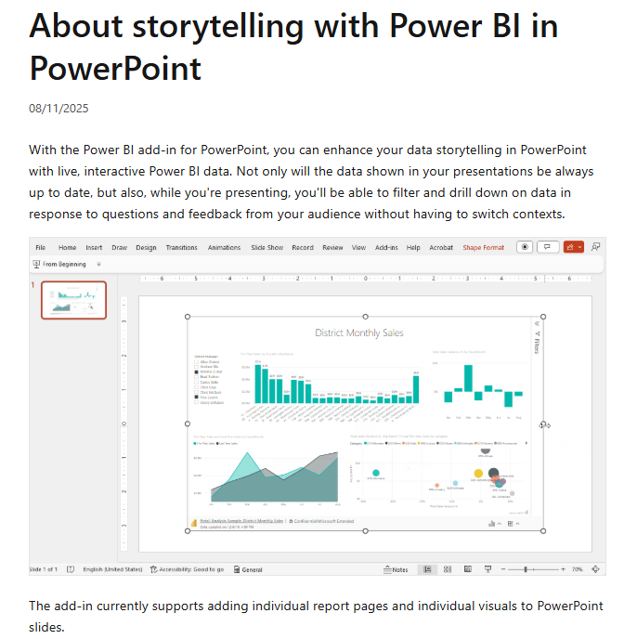
Storytelling with Power BI in PowerPoint
https://learn.microsoft.com/en-us/power-bi/collaborate-share/service-power-bi-powerpoint-add-in-about

Slide 32
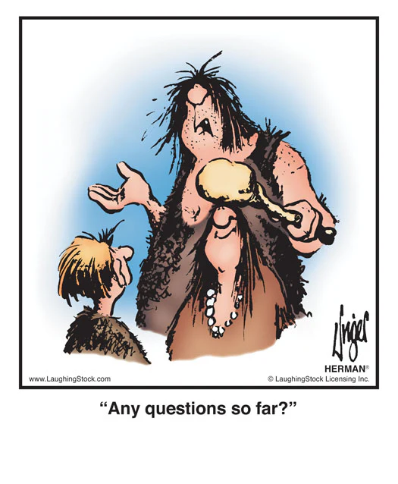
Questions?

Slide 33

That’s a wrap

Slide 34
Assignment 2
Crafting and articulating that Compelling Story

Slide 35
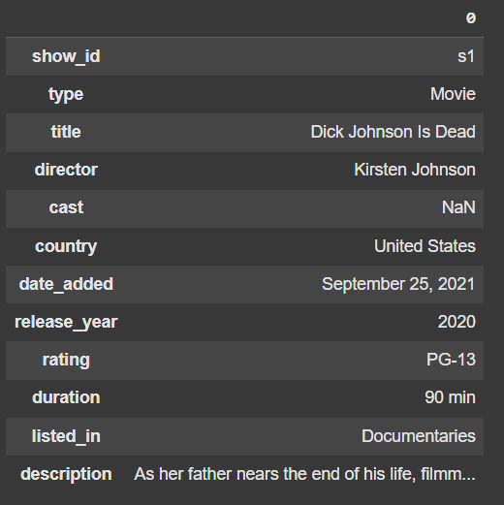
Dataset
https://www.kaggle.com/datasets/shivamb/netflix-shows
About this Dataset: Netflix is one of the most popular media and video streaming platforms. They have over 8000 movies or TV shows available on their platform. As of mid-2021, they have over 200 million subscribers globally.
This tabular dataset consists of listings of all the movies and TV shows available on Netflix, along with details such as cast, directors, ratings, release year, duration, etc.

Slide 36
Context
Counter the threat of GenAI-generated movies: a study of Rajiv Chilaka vs. Martin Scorsese
You have been hired by a cool animation startup in LA to draw insights from the works of Rajiv Chilaka and Martin Scorsese based on the data available in this dataset.
You will then use these insights to recommend strategies for them to counter the threat of GenAI-generated movies.

Slide 37

Rajiv Chilaka
Highest number of directed movies in the dataset
Rajiv Chilaka is an Indian animation filmmaker known for his work on shows like “Chhota Bheem” and “KikoRiki”.

Slide 38

Martin Scorsese
You know… the guy who directed Goodfellas, The Departed, The Irishman, etc.
Martin Scorsese is an American film director known for his gritty, intense films like “Goodfellas”, “The Departed”, and “The Irishman”.

Slide 39
Deliverables
Executive Summary & Supporting Analysis
A one-page executive summary detailing the analysis, insights, and recommendations.
One killer figure.
Additional supporting analysis can be included as an appendix.

Slide 40
Grading Criteria
How well can you craft and articulate the story
Crafting the Compelling Story (50%)
Depth and relevance of insights drawn from the data analysis
Articulating the Compelling Story (50%)
Clarity, coherence, and organization of the executive summary
Effectiveness of recommendations for countering GenAI threats
Originality and creativity of the approach
Ability to identify and leverage key relationships, trends and patterns in the data
Use of effective visualizations to support findings and recommendations
Ability to communicate complex ideas and insights in a clear and concise manner

Slide 41
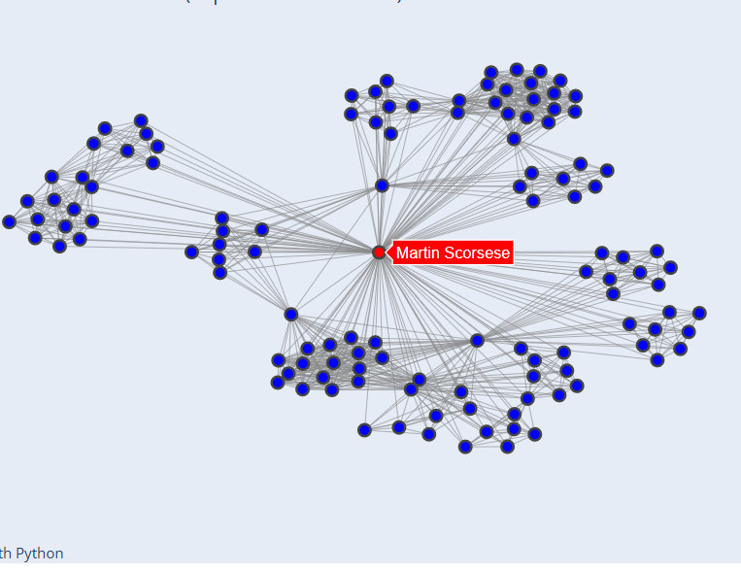
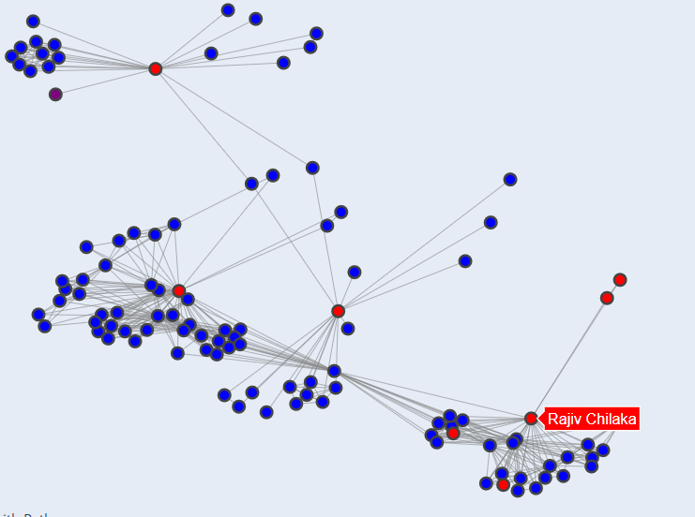
Network analysis
Who are these guys working with?
More on this next week

Slide 42
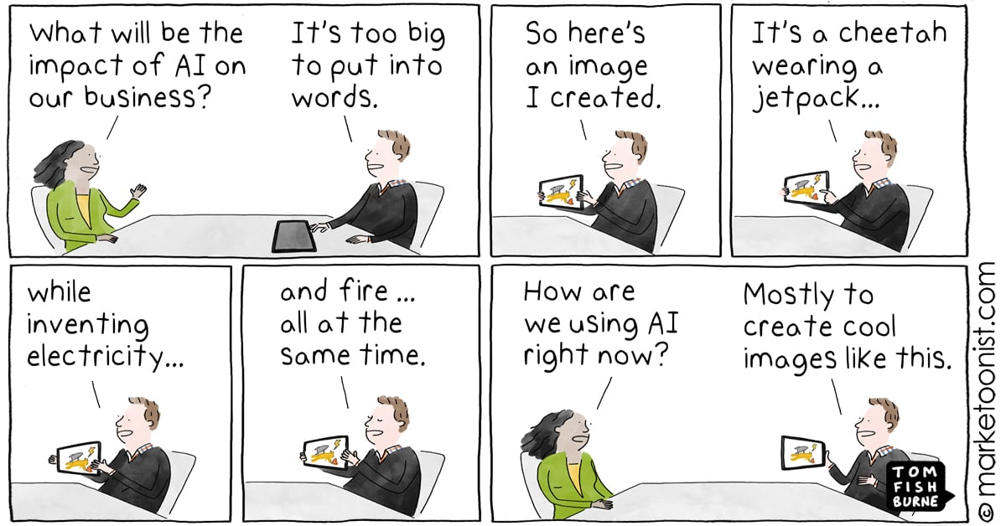

Slide 43
Team Project
Building your “killer figure”

Slide 44
Team Project Description
Building your “killer figure”
Context
You are pitching a business case to a group of senior technology executives at your company, but a call came in, and the CTO will have to leave the meeting in 5 minutes.

Slide 45
Team Project Description
Building your “killer figure”
Challenge
You have 5 minutes to summarize your key findings, assumptions, and/or projections to convince your CTO that YOUR project is worth funding.

Slide 46

Ryan Buell’s famous “Killer Figure”
Professor from Harvard Business School https://www.hbs.edu/faculty/Pages/profile.aspx?facId=320524
“You should be able to summarize your entire presentation using ONE KILLER FIGURE.”

Slide 47
Team Project Description
Building your “killer figure”
Your Tasks
Identify a domain that is interesting to your team.
Find a dataset in that domain (common places to look: HuggingFace, Kaggle, UCI, Papers with Code)
Craft a project idea based on the data you are using (more on the next slide)
Create one killer figure that clearly tells your story
5-minute in-class presentation using the killer figure

Slide 48
Team Project Description
Building your “killer figure”
Project Objectives
Crafting a compelling story with data
Clearly articulate that story with one killer figure
Be creative and have fun

Slide 49
Team Project Description
Building your “killer figure”
Crafting Your Idea
What problems are you trying to solve?
What questions are you trying to answer?
What kind of data will you need?

Slide 50
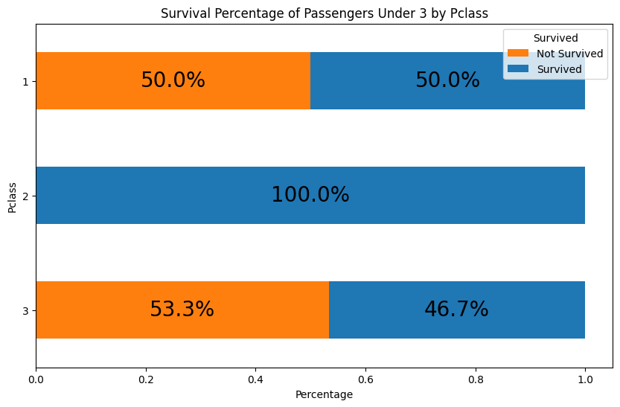
Team Project Description
Building your “killer figure”
Punchline:
The first-class children have only a slightly higher survival percentage (50%) than the third-class children (46.7%)!

Slide 51
Team Project Description
Building your “killer figure”
The first-class children pay, on average $151, which is 6 times higher than third-class children, who pay, on average $23. And yet, the company failed to ensure their safety.
Business proposal to
Improve the overall survival percentage for all children.

Slide 52
Team Project Description
Building your “killer figure”
Watch this video for inspiration (as needed)
How Consulting Firms Make Complex Topics Simple
Analyst Academy

Slide 53
Common Data Sources
Some recommendations
Huggingface: https://huggingface.co/docs/datasets/en/index
Kaggle: https://www.kaggle.com/datasets (Here you will also easily find code/notebooks from others, but be careful when using someone else's code - it might take more time to debug than write your own)
UCI: https://archive.ics.uci.edu/datasets
Papers with code: https://paperswithcode.com/datasets (this one is great if you want to read the research that's been done on the particular dataset)

Slide 54

Questions?

